Slide 1


AMAZON product ANALYSIS
JACKY YADAV

Slide 2
INSIGHTS
The dataset is having the data of 1K+ Amazon Product's Ratings and Reviews as per their details listed on the official website of Amazon
Product Category Analysis
01
Product Ratings Analysis
02
Product Pricing Analysis
04
Product Reviewer’s Analysis
03

Slide 3
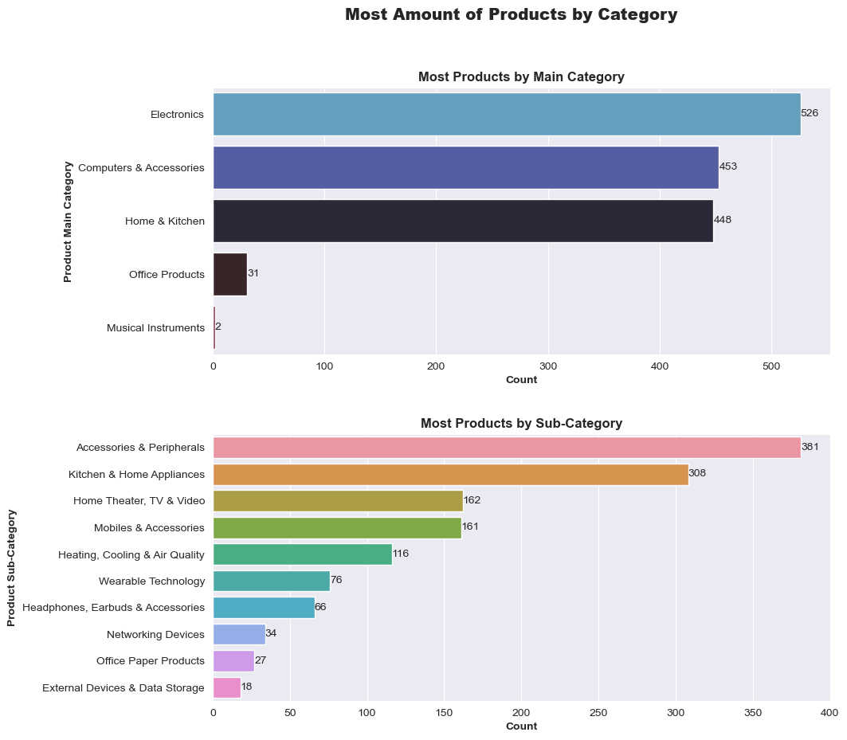
Category Analysis
Electronics especially accessories & peripherals and kitchen & home appliances covers most of the products in this dataset.

Slide 4
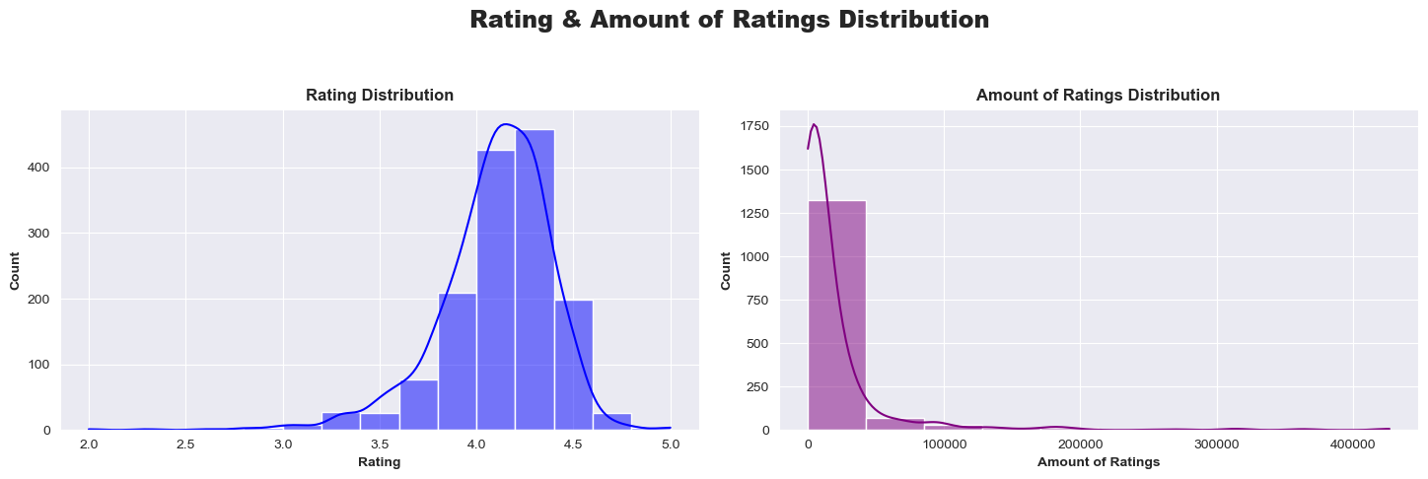
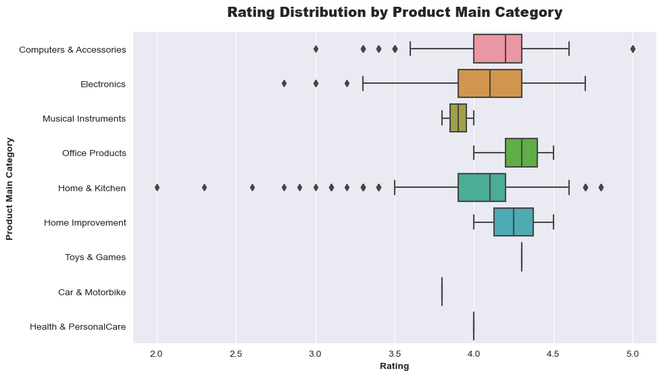
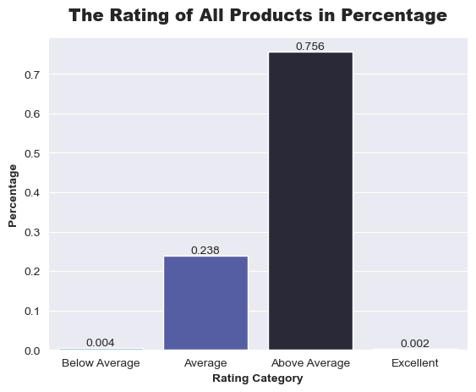
Rating Analysis
Most of the product rating range around 4.0 – 4.375
Ratings vary across categories. Car & Motorbike, Toys & Games, and Health & Personal Care typically rate between 3.75 - 4.375. Home Improvement and Office Products receive a minimum rating of 4.0. Computer & Accessories and Electronics cover a range from 3.6 - 4.6, with outliers at 2.75 and 5.0. Home & Kitchen exhibits the widest range from 2.0 - 4.75, though most products score between 3.8 - 4.6.
Most products rated Above Avg and nothing rated Poor

Slide 5
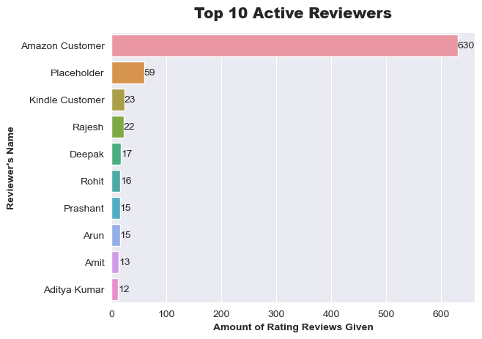
Reviewers Analysis
More than 600 people who reviewed a product and give rating anonymously under the alias of Amazon Customer, Place Holder, and Kindle Customer.
There are more than 8 people who have given ratings and reviews to more than 10 products.

Slide 6
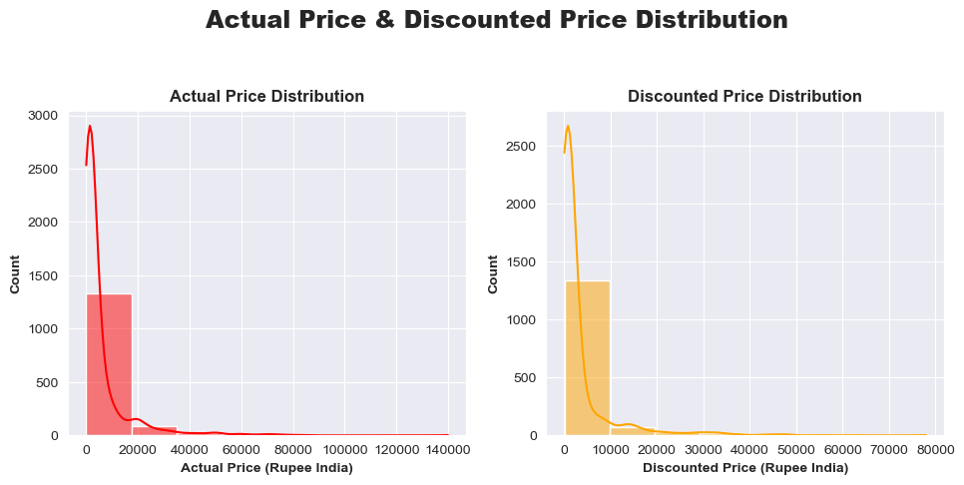
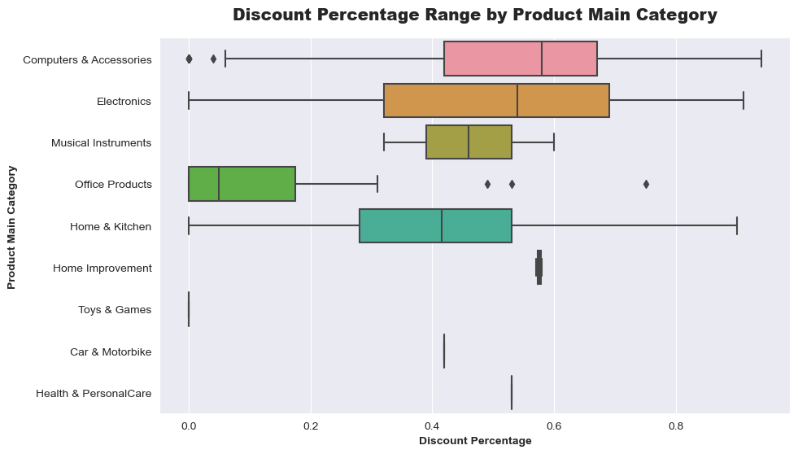
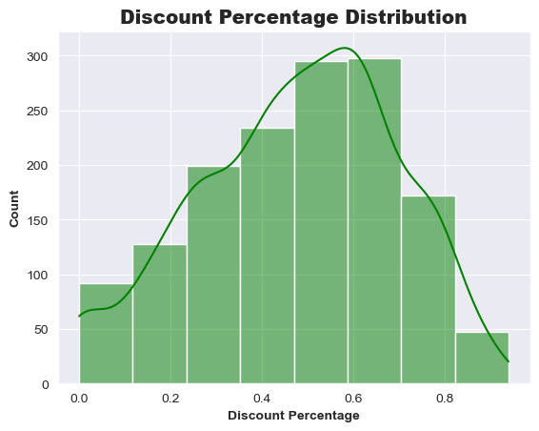
Pricing Analysis
Actual Price Vs Discounted Prices have same distribution
Most products have discounts at around 50% - 70%.
Computers & Accessories, Electronics and Home & Kitchen products have a large spread of discount variation from 0% to 90% discount. Toys & Games, Cars & Motorbikes, Health & Personal Care, and Home Improvement have the least spread
Office Products does not give a large amount of discount compared to other products in the Main Category.

